Slide 1
SEMINAR IN HRM
COURSE : SEMINAR IN HRM
CLASS : BS COMMERCE
SEMESTER : 8TH
TOPIC : PERFORMANCE MANAGEMENT AND APPRAISAL
EMAIL : FAHEEMORG85@GMAIL.COM
(FOR QUERIES KINDLY EMAIL ON TO THIS ID)

Slide 2
LEARNING OBJECTIVES
1. Define performance management and discuss how it
differs from performance appraisal.
2. Describe the appraisal process.
3. Set effective performance appraisal standards.
4. Develop, evaluate, and administer at least four
performance appraisal tools.
5. Explain and illustrate the problems to avoid in
appraising performance.
6. Discuss the pros and cons of using different raters to appraise a person s performance.
7. Perform an effective appraisal interview.

Slide 3
BASIC CONCEPTS IN PERFORMANCE MANAGEMENT
AND APPRAISAL
Few things supervisors do are fraught with more peril than appraising subordinates performance.
Employees tend to be overly optimistic about what their ratings will be. They also know that their raises, careers, and peace of mind may hinge on how you rate them.
Few appraisal processes are as fair as employers think they are. Hundreds of obvious and not-so-obvious problems (such as bias, and the tendency for supervisors to rate everyone average ) distort the process.
However, the perils notwithstanding, performance appraisal plays a central role in human resource management.

Slide 4
The Performance Appraisal process
Performance appraisal means evaluating an employee s current and/or past performance relative to his or her performance standards.
You may equate appraisal forms like Figure 9-1(next slide) with performance appraisal, but appraisal involves more than form Effective appraisal also requires that the supervisor set performance standards. And it requires that the employee receives the training, feedback, and incentives required to eliminate performance deficiencies.
Effective appraisals begin before the actual appraisal, with the manager defining the employee s job and performance criteria.
Defining the job means making sure that you and your subordinate agree on his or her duties and job standards and on the appraisal method you will use. Stripped to its essentials, performance appraisal always involves the 3-step performance appraisal process:
Setting work standards
Assessing the employee s actual performance relative to those standards (this usually involves some rating form)
Providing feedback to the employee with the aim of helping him or her to eliminate performance deficiencies or to continue to perform above par. s.

Slide 5
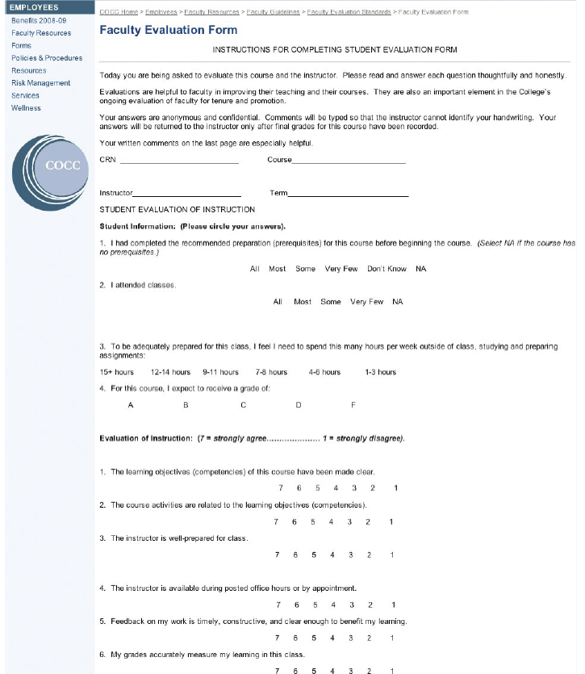
CONTD:-

Slide 6
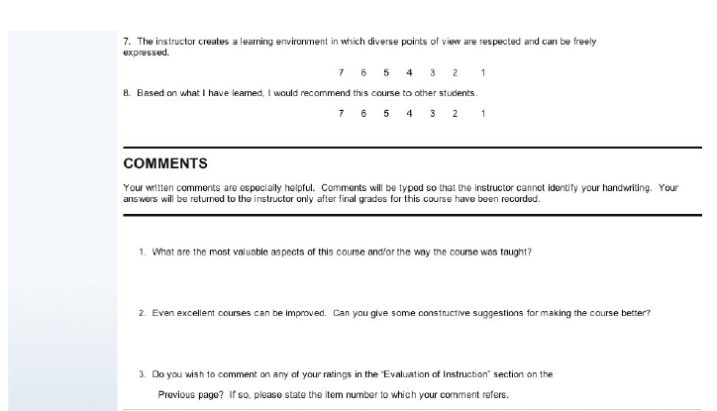
CONTD:-

Slide 7
Why Appraise Performance?
There are five reasons to appraise subordinates performance.
* First, most employers still base pay, promotion, and retention decisions on the
employee s appraisal.3
* Second, appraisals play a central role in the employer s performance management
process. Performance management means continuously making sure that each
employee s and teams performance makes sense in terms of the company s
overall goals. The accompanying HR as a Profit Center feature illustrates this.
* Third, the appraisal lets you and the subordinate develop a plan for correcting
any deficiencies, and to reinforce the things the subordinate does right.
* Fourth, appraisals should facilitate career planning. They provide an opportunity
to review the employee s career plans in light of his or her exhibited strengths and
weaknesses.
* Finally, supervisors use appraisals to identify employees training and development
needs. The appraisal should enable the supervisor to identify if there is a performance
gap between the employee s performance and his or her standards. And it
should help identify the cause of any such gap, and the remedial steps required.

Slide 8
The Importance of Continuous Feedback
For accomplishing several of these aims, traditional annual or semiannual appraisal reviews make sense. For example, promotions and raises tend to be periodic decisions.
Similarly, you probably wouldn t want to make career decisions without at least several months of data gathering and introspection.
However, it s usually a mistake to wait until the actual appraisal to let employees know what they re doing wrong and doing right. Aligning the employee s efforts with
the job s standards should be a continuous process. When you see a performance problem, the time to take action is immediately there is no substitute for nudging your employee s performance back into line continuously and incrementally.
Similarly, when someone does something well, the best reinforcement comes
immediately, not 6 months later.

Slide 9
Performance Management defined
Recognizing this, many employers today take a more continuous approach to the performance appraisal cycle. For example, at Toyota Motor s Lexington, Kentucky, Camry plant, the supervisors don t sit with individual employees to fill out forms and appraise them. Instead, teams of employees monitor their own results, even posting individual daily performance metrics. In frequent meetings, they continuously align those results with the work teams standards and with the plant s overall quality and productivity needs. They do this by continuously adjusting how they and their team members do things.
Team members who need coaching and training receive it, and procedures that need changing are changed. This is performance management in action.
PERFORMANCE MANAGEMENT DEFINED
Performance management means different things to different people. Some use performance management as just a new way of saying performance appraisal. Others say performance appraisal represents just the appraisal step of a three-step goal-setting/appraisal/feedback performance management process.
In this book,we assume that performance management is a uniquely goal-oriented and continuous way to appraise and manage employees performance. It is the continuous process of identifying, measuring, and developing the performance of individuals and teams and aligning their performance with the organizations goals.
The difference between performance management and performance appraisal is more than a matter of degree; it s a matter of substance.

Slide 10
CONTD:-
Many employers have what they call performance management processes, but in fact still use traditional performance appraisal. Continuous feedback and strategically related performance criteria are the two distinguishing characteristics of performance management. As one expert puts it, a system that involves employee evaluations once a year without an ongoing effort to provide feedback and coaching so that performance can be improved is not a true performance management system.
Similarly, performance management systems that do not make explicit the employee contribution to the organizational goals are not true performance management systems.

Slide 11
Defining the Employee s Goals and Performance Standards
Most employees need and expect to know ahead of time on what basis their employerwill appraise them.
Ideally, each employee s goals should derive from and contribute to the company s overall aims. The manager s goals flow from the vice president s, whose goals flow from the president s, for instance. However, setting useful goals is not as simple as it may appear. There is an art to setting effective goals.
First, the supervisor must decide what to measure. Many employers simply use packaged employee appraisal forms with generic scales, similar to that in Figure 9-1. That appraisal form shows what will be measured, for instance, The instructor is well-prepared for class. Other firms use a management by objectives approach. Thus, the CEO may have a goal to double sales this year. Based on that, her vice president of sales has his or her own sales goals, and each salesperson has his or her sales goal, set in discussions with his or her supervisor.
It is typical to set measurable goals for each expectation you have for the employee. Suppose you expect your sales manager to handle the company s three biggest accounts personally, and to manage the sales force. You might measure the personal selling activity in terms of a money goal how many dollars of sales the manager is to generate personally. You might measure managing the sales force in terms of a turnover goal (on the assumption that less than 10% of the sales force will quit in any given year if morale is high). But is, say, a 10% turnover goal reasonable? One way to think of this is to remember that effective goals are SMART. They are specific, and clearly state the desired results. They are measurable, and answer the question How much? They are attainable. They are relevant, and clearly derive from what the manager and company want to achieve. And they are timely, and reflect deadlines and milestones.

Slide 12
HR IN PRACTICE: HOW TO SET EFFECTIVE GOALS Behavioral science
Research studies suggest four guidelines for setting performance goals:
1. Assign specific goals. Employees who receive specific goals usually perform
better than those who do not.
2. Assign measurable goals. Put goals in quantitative terms and include target dates
or deadlines.
3. Assign challenging but doable goals. Goals should be challenging, but not so
difficult that they appear impossible or unrealistic.
4. Encourage participation. The evidence suggests that participatively set goals do not
consistently result in higher performance than assigned goals, nor do assigned
goals consistently result in higher performance than participatively set ones. It is
only when the participatively set goals are more difficult (are set higher) than the
assigned ones that the participatively set goals produce higher performance. Because
it tends to be easier to set higher standards when your employees participate in
the process, participation tends to facilitate standards setting and performance.

Slide 13
TALENT MANAGEMENT: BASING APPRAISAL STANDARDS ON REQUIRED
COMPETENCIES
Other firms appraise employees based on the competencies and skills the job requires. For example, BP s exploration division appraises and rewards employees based on a skills matrix. This matrix shows (1) the basic skills required to do that job (such as technical expertise ) and (2) the minimum level of each skill that job requires.
THE ROLE OF JOB DESCRIPTIONS
Ideally, what to appraise and how to appraise it will be obvious from the job description. In terms of what criteria to appraise, the job description should list the job s duties or tasks, including how critical each is to the job, and how often it s performed. For example, a nurse s job description may include safely administer patient medication as a task. You might then appraise the nurse on how well he or she safely administers patient medication, for instance using data from periodic hospital safety inspections.
The job description may also include strategically important behaviors such as building patient trust and satisfaction. Their presence (either in the job descriptions list of duties or in a separate list of strategically relevant core behaviors ) enables the manager to identify competencies (such as quality consciousness ) to appraise that support the employers strategic aims.

Slide 14
Who Should Do the Appraising?
Appraisals by the immediate supervisor are still the heart of most appraisal processes. Getting a supervisor s appraisal is relatively straightforward and makes sense. The supervisor is usually in the best position to observe and evaluate his or her subordinate s performance. The supervisor is also responsible for that persons performance.
The human resources department serves a policy-making and advisory role. Generally, human resource managers provide the advice and the appraisal tool to use, but leave final decisions on procedures to operating division heads. The human resource team should also be responsible for training supervisors to improve their appraisal skills, for monitoring the appraisal systems effectiveness, and for ensuring that it complies with EEO laws.
Yet, although widely used, relying only on supervisors appraisals isn't always advisable. For example, an employee s supervisor may not understand or appreciate how customers and colleagues see the employees performance. Furthermore, there is always some danger of bias for or against the employee. If so, managers have several options.

Slide 15
CONTD:-
1. PEER APPRAISALS
With more firms using self-managing teams, appraisal of an employee by his or her peers peer appraisal is popular. Typically, an employee due for an annual appraisal chooses an appraisal chairperson. The latter then selects one supervisor and three peers to evaluate the employee s work. Research indicates that peer appraisals can be effective.One study involved undergraduates placed into self-managing work groups. The researchers found that peer appraisals had an immediate positive impact on [improving] perception of open communication, task motivation, social loafing, group viability, cohesion, and satisfaction.
Employees, in other words, seem to be motivated to meet their colleagues expectations.
2. RATING COMMITTEES
A rating committee is usual composed of the employee s immediate supervisor and three or four other supervisors.Using multiple raters is advantageous. It can help cancel out problems such as bias on the part of individual raters.
It can also provide a way to include in the appraisal the different facets of an employee s performance observed by different appraisers. Multiple raters often see different facets of an employee s performance.
Studies often find that the ratings obtained from different sources rarely match.
Its therefore advisable to obtain ratings from the supervisor, his or her boss, and at least one other manager who is familiar with the employee s work.1At a minimum, most employers require that the supervisor s boss sign off on any appraisals the supervisor does.

Slide 16
CONTD:-
3. SELF-RATINGS
Some employers obtain employees self-ratings, usually in conjunction with supervisors ratings. The basic problem, of course, is that employees usually rate themselves higher than do their supervisors or peers.
One study found that, when asked to rate their own job performances, 40% of employees in jobs of all types placed themselves in the top 10%, and virtually all remaining employees rated themselves at least in the top 50%.20 In another study, subjects self-ratings correlated negatively with their subsequent performance in an assessment center the higher they appraised themselves, the worse they did in the center. In contrast, an average of the persons supervisor, peer, and subordinate ratings predicted the subjects assessment center performance.
4. APPRAISAL BY SUBORDINATES
Many employers have subordinates rate their managers, usually for developmental rather than for pay purposes. Anonymity affects the feedback. Managers who receive feedback from subordinates who identify themselves view the upward feedback process more positively. However, subordinates prefer giving anonymous responses (not surprisingly), and those who must identify themselves tend to give inflated ratings.
The evidence suggests that upward feedback can improve a manager s performance. One study focused on 252 managers during five annual administrations of an upward feedback program. Managers who were initially rated poor or moderate showed significant improvements in [their] upward feedback ratings over the five-year period. In another study, cynicism toward management and inadequate time to interact with the boss reduced the upward appraisal s usefulness.
And, managers who met with their subordinates to discuss their upward feedback improved more than the managers who did not.

Slide 17
CONTD:-
5. 360-DEGREE FEEDBACK
With 360-degree feedback, the employer collects performance information all around an employee from his or her supervisors, subordinates, peers, and internal or external customers generally for developmental rather than pay purposes.
The usual process is to have the raters complete online appraisal surveys on the ratee. Computerized systems then compile all this feedback into individualized reports to ratees (see the sample in Figure 9-2). The person may then meet with his or her supervisor to develop a self-improvement plan.
Results are mixed. Participants seem to prefer this approach, but one study concluded that multisource feedback led to generally small improvements in subsequent ratings by supervisors, peers, and subordinates. Improvement was most likely to occur when the feedback the person received indicated that change was necessary, and when the recipients believed that change was necessary and had a positive view of the change process.
Also, 360-degree appraisals are more candid when subordinate know rewards or promotions are not involved.

Slide 18
CONTD:-
There are several ways to improve 360-degree appraisals.
* Anchor the 360-degree rating dimensions (such as conflict management ) with specific behavioral examples (such as effectively deals with conflicts ).
* Carefully train the people who are giving and receiving the feedback.
* With so many appraisers involved, each potentially with his or her own ax to grind, make sure that the feedback the person receives is productive, unbiased, and development oriented.
* Reduce the administrative costs associated with collecting multisource feedback by using a Web-based system such as the one in Figure 9-2. This lets the rater log in, open a screen with a rating scale, and rate the person along a series of competencies
with ratings such as capable and effective.

Slide 19
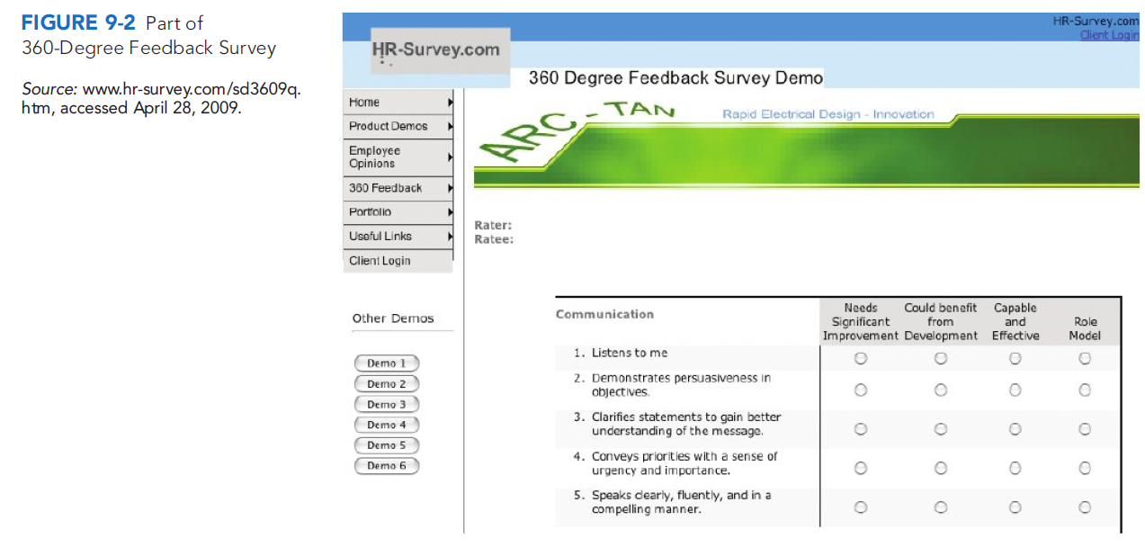
CONTD:-

Slide 20
New topic :TECHNIQUES FOR APPRAISING PERFORMANCE
The manager generally conducts the actual appraisal using a formal tool or method like one or more of those described next.
The two basic questions in designing the actual appraisal tool are what performance dimensions to measure, and how to measure them. For example, in terms of what dimensions to measure, we might measure the employee s performance in terms of generic dimensions such as quality and timeliness, or with respect to achieving specific goals.
In terms of how to measure it, you can use one or more of various tools or methods, such as graphic rating scales or forced distribution ( grading on a curve ).We’ll start with the most popular, graphic rating scales.
Graphic Rating Scale Method
Alternation Ranking Method
Paired Comparison Method
Forced Distribution Method
Critical Incident Method
Narrative Forms
Behaviorally Anchored Rating Scales
Mixed Standard Scales
Management by objectives
Computerized and web based performance appraisal
Electronic performance monitering

Slide 21
CONTD:-
1 Graphic Rating Scale Method
The graphic rating scale is the simplest and most popular method for appraising performance. Figure 9-3 shows one graphic rating scale.
A graphic rating scale lists traits or performance dimensions (such as communication or teamwork ) and a range of performance values (from below expectations to role model or unsatisfactory to
outstanding, ) for each trait.
The supervisor rates each subordinate by circling or checking the score that best describes the subordinate s performance for each trait. The manager then totals the assigned ratings for the traits.
WHAT TO RATE? We can use graphic ratings scales to illustrate the range of traits
or performance dimensions one might evaluate. For example:
As in Figure 9-3, some rating scales assess generic job dimensions such as communications, teamwork, know-how, and quantity.
Another option is to rate the employee s performance on the job s actual duties. For example, Figure 9-4 shows part of an appraisal form for a pizza chef. This assesses the job s main specific duties, one of which is Maintain adequate inventory of pizza dough. Here you would assess how well the employee did in exercising each of these duties. Or, you might rate (as in Section I of Figure 9-5) how well the employee did wit respect to achieving specific performance expectations or objectives.Although not in the figure, sell $600,000 worth of products per year illustrates a performanceexpectation/objective.

Slide 22
CONTD:-
* Competency-based appraisal forms are another option. Here you focus on the
extent to which the employee exhibits the competencies (generally the skills
and/or knowledge) needed to perform the job. Section II of Figure 9-5 illustrates
this appraisal approach.
To illustrate, one competency that a nurse supervisor should bring to the job might be builds a culture that is open and receptive to improved clinical care. Why appraise such competencies? Suppose this hospital s strategic goals include improving quality of patient care. If so, then focusing the nurse supervisor s attention on improving his or her clinical care competencies better supports the hospital s strategy than would appraising how he or she rates on duties like supervise one dozen nurses.
Some graphic rating forms appraise several things. For example, Figure 9-5 (Sections I and II) assesses the employee s performance relating to both competencies and objectives. With respect to competencies, the employee is expected to develop and exhibit competencies (Section II) such as identifies and analyzes problems (Problem Solving), and maintains harmonious and effective work relationships with co-workers and constituents (Teamwork). The employee and supervisor would fill in the objectives section (Section I) at the start of the year, and then rate results and set new ones as part of the next appraisal.

Slide 23
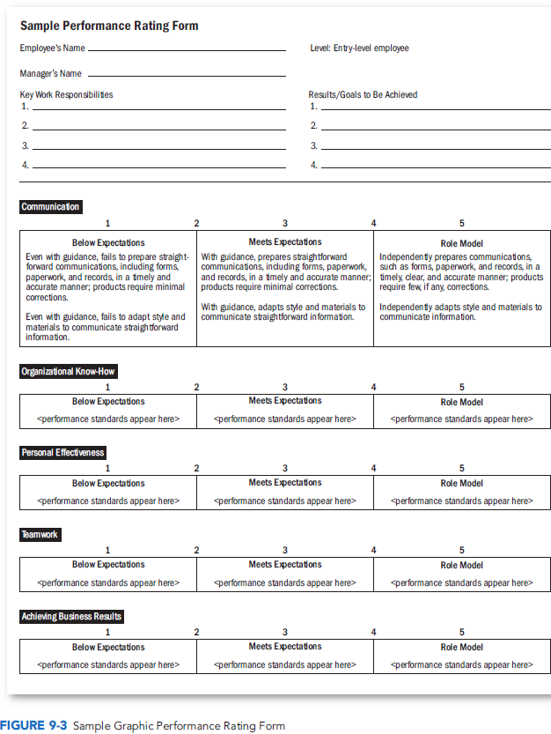
CONTD:-

Slide 24
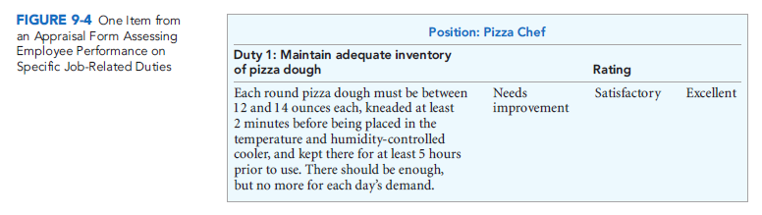
CONTD:-

Slide 25
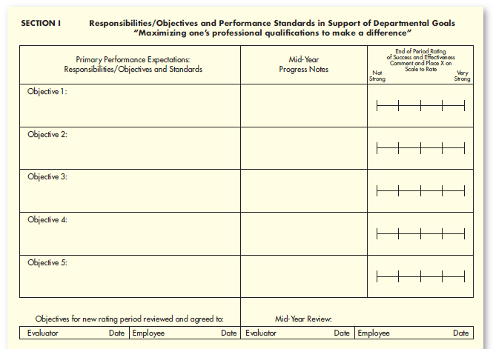
FIG 9.5

Slide 26
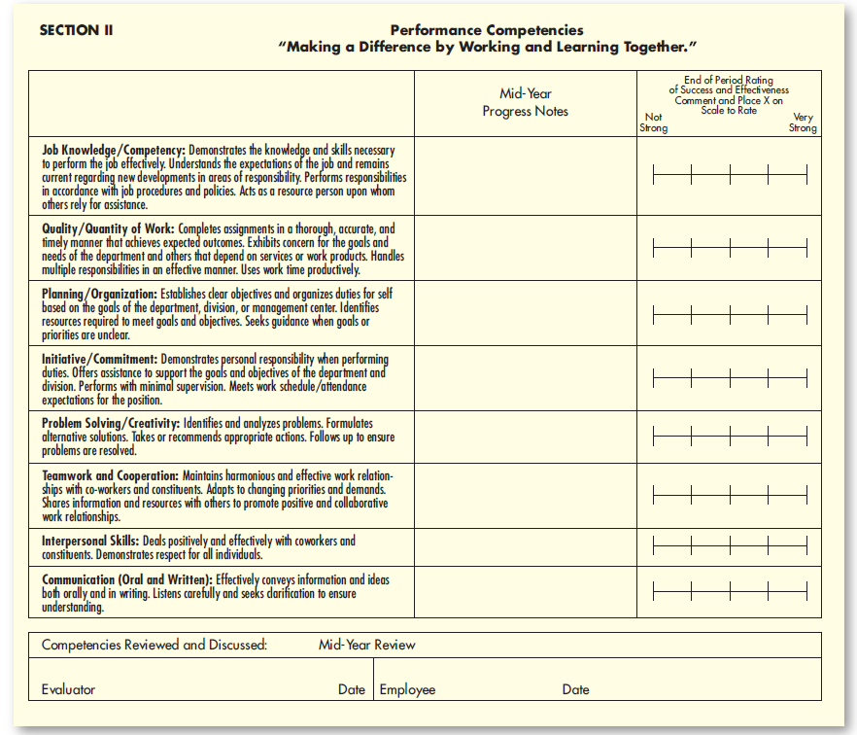
CONTD:-

Slide 27
CONTD:-
2. Alternation Ranking Method
Ranking employees from best to worst on a trait or traits is another option. Since it is usually easier to distinguish between the worst and best employees, an alternation ranking method is most popular. First, list all subordinates to be rated, and then cross out the names of any not known well enough to rank. Then, on a form like that in Figure 9-6, indicate the employee who is the highest on the performance dimension being measured and the one who is the lowest.Then choose the next highest and the next lowest, alternating between highest and lowest until all employees have been ranked. Paired Comparison Method
3. The paired comparison method
helps make the ranking method more precise. For every trait (quantity of work, quality of work, and so on), you pair and compare every subordinate with every other subordinate.
Suppose you have five employees to rate. In the paired comparison method, you make a chart, as in Figure 9-7, of all possible pairs of employees for each trait. Then, for each trait, indicate (with a *or +) who is the better employee of the pair.Next, add up the number of *s for each employee. In Figure 9-7,Maria ranked highest (has the most
marks) for quality of work, whereas Art was ranked highest for creativity.
4. Forced Distribution Method
The forced distribution method is similar to grading on a curve.With this method, you place predetermined percentages of ratees into several performance categories. The proportions in each category need not be symmetrical; GE used top 20%, middle 70%, and bottom 10% for its managers. (GE now tells managers to use more discretion in assigning rankings, and no longer strictly adheres to its famous 20/70/10 split.)32 Forced distribution makes some sense. It reflects the fact that top employees often outperform average or poor ones by as much as 100%.33 About a fourth of Fortune 500 companies including Microsoft, Conoco, and Intel use versions of forced distribution.

Slide 28
CONTD:-
As most students know, forced grading systems are unforgiving. With forced distribution, you re either in the top 5% or 10% (and thus get that A ), or you re not. And, if you re in the bottom 5% or 10%, you get an F, no questions asked. Your professor hasn t any wiggle room. Some students must fail. One survey found that 77% of responding employers using this approach were at least somewhat satisfied with forced ranking, while the remaining 23% were dissatisfied. The biggest complaints: 44% said it damages morale. Forty-seven percent said it creates interdepartmental inequities: High performing teams must cut 10% of their workers while low performing teams are still allowed to retain 90% of theirs.
Some writers refer unkindly to forced rankings as Rank and Yank. Given this, to protect against unfairness and bias claims, managers should take several steps.Appoint a review committee to review any employee s low ranking. Train raters to be objective, and consider using multiple raters in conjunction with the forced distribution approach.And remember that distinguishing between top and bottom performers is usually not even the problem: The challenge is to differentiate meaningfully between the other 80%.

Slide 29
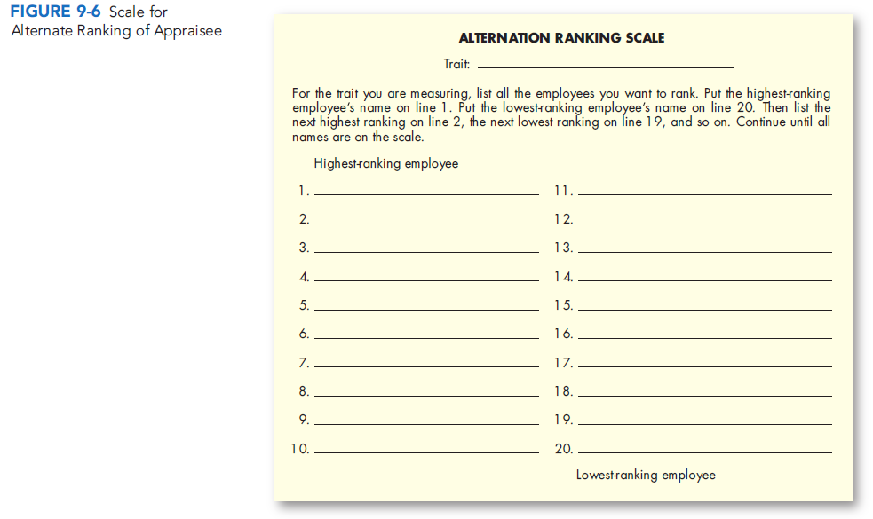
CONTD:-

Slide 30
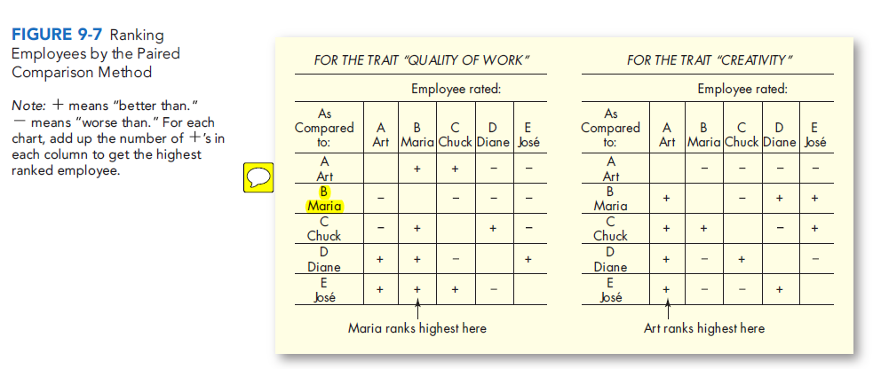
CONTD:-

Slide 31
CONTD:-
5. Critical Incident Method
With the critical incident method, the supervisor keeps a log of positive and negative examples (critical incidents) of a subordinate s work-related behavior. Every 6 months or so, supervisor and subordinate meet to discuss the latter s performance, using the incidents as examples.
Compiling incidents is useful. It provides examples of good and poor performance the supervisor can use to explain the person s rating. It makes the supervisor think about the subordinate s appraisal all during the year (so the rating does not just reflect the employee s most recent performance). And the list provides examples of how the subordinate can eliminate deficiencies. The downside is that without some numerical rating, this method is not as useful for comparing employees or for salary decisions.
In any case, it is common to accumulate incidents to illustrate the reasons behind the employee s ratings. In Table 9-1, one of the assistant plant manager s continuing duties was to supervise procurement and to minimize inventory costs. The critical incident log shows that he or she let inventory storage costs rise 15%; this provides an example of what performance to improve.
6. Narrative Forms
All or part of the written appraisal may be in narrative form. Figure 9-8 presents an example. Here the person s supervisor assesses the employee s past performance and required areas of improvement. The supervisor s narrative assessment aids helps the employee understand where his or her performance was good or bad, and how to improve that performance.

Slide 32
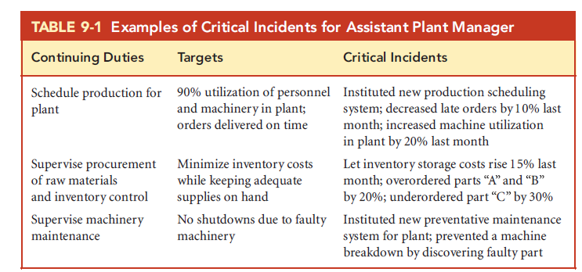
CONTD:-

Slide 33
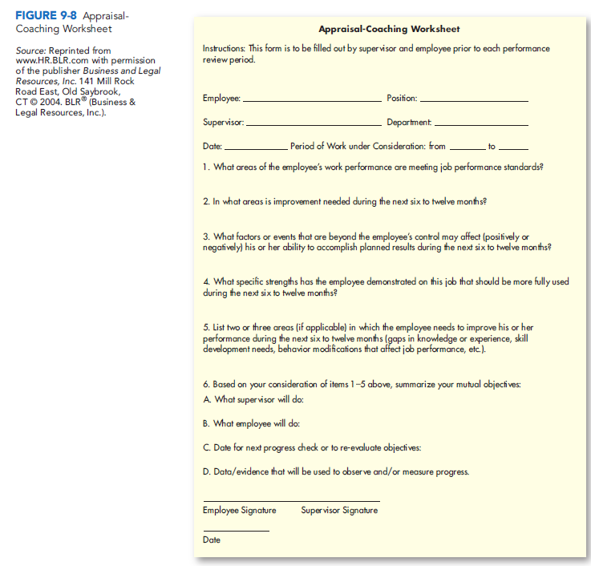

Slide 34
CONTD:-
7. Behaviorally Anchored Rating Scales
A behaviorally anchored rating scale (BARS) is an appraisal tool that anchors a
numerical rating scale with specific illustrative examples of good or poor performance.
Its proponents say it provides better, more equitable appraisals than do the other tools
we discussed.
Developing a BARS typically requires five steps:
1. Write critical incidents. Ask the job s jobholders and/or supervisors to write
specific illustrations (critical incidents) of effective and ineffective performance
on the job.
2. Develop performance dimensions. Have these people group the incidents
into 5 or 10 performance dimensions, such as salesmanship skills.
3. Reallocate incidents. To verify these groupings, have another team of people who
also know the job reallocate the original critical incidents. They must reassign
each incident to the cluster they think it fits best. Retain a critical incident if most
of this second team assigns it to the same cluster as did the first group.
4. Scale the incidents. This second group then rates the behavior described by
the incident as to how effectively or ineffectively it represents performance on the
dimension (7- to 9-point scales are typical).
5. Develop a final instrument. Choose about six or seven of the incidents as the
dimension s behavioral anchors.We ll look at an example.

Slide 35
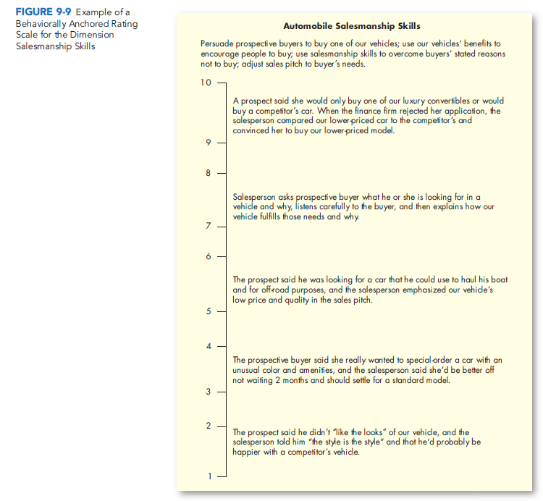

Slide 36
CONTD:-
RESEARCH INSIGHT Three researchers developed a BARS for grocery checkout
clerks.They collected many critical incidents, and then grouped or clustered these
into eight performance dimensions:
Knowledge and Judgment
Conscientiousness
Skill in Human Relations
Skill in Operation of Register
Skill in Bagging
Organizational Ability of Checkstand Work
Skill in Monetary Transactions
Observational Ability
They then developed behaviorally anchored rating scales for each of these dimensions. Each BARS contained a scale (ranging from 1 to 9) for rating performance from extremely poor to extremely good. Then a specific critical incident (such as by knowing the price of items, this checker would be expected to look for mismarked and unmarked items ) helped anchor or specify what was meant by extremely good (9) performance. Similarly, they used several other critical incident anchors along the performance scale from (8) down to (1). To illustrate, Figure 9-9 (previous slide)shows a BARS for one performance dimension for a car sales person the dimension automobile salesmanship skills.

Slide 37
CONTD:-
ADVANTAGES It takes more time to develop a BARS, but the tool has advantages.
1. A more accurate gauge. People who know the job and its requirements better
than anyone develop the BARS. This should produce a good gauge of job
performance.
2. Clearer standards. The critical incidents along the scale illustrate what to look
for in terms of superior performance, average performance, and so forth.
3. Feedback. The critical incidents make it easier to explain the ratings to appraisees.
4. Independent dimensions. Clustering the critical incidents into five or six performance
dimensions (such as salesmanship skills ) helps to make the performance
dimensions more independent of one another. For example, a rater should be
less likely to rate an employee high on all dimensions simply because he or she was
rated high in salesmanship skills.
5. Consistency.42 BARS evaluations seem to be relatively reliable, in that different
raters appraisals of the same person tend to be similar.

Slide 38
CONTD:-
8. Mixed Standard Scales
Mixed standard scales are somewhat similar to behaviorally anchored scales. However, mixed scales generally list just a few (usually 3) behavioral examples (or standards ) for each of, say, 3 performance dimensions. The employer then mixes the resulting behavioral examples statements when listing them. The aim is to reduce rating errors by making it less obvious to the person doing the appraising (1) what performance dimensions he or she is rating; and (2) whether the behavioral example statements represent high, medium, or low performance. The supervisor rates the employee by indicating whether the latter s performance is better than, the same, or worse than the statement.
Suppose you want to appraise employees on the dimensions Quality of Work, Conscientiousness, and Gets Along with Others.You write three high,medium, low behavioral examples for each of these three dimensions, as follows.
For Quality ofWork:
Employee s work is striking in its accuracy, there is never any evidence of carelessness in it.The accuracy of employee s work is satisfactory; it is not often that you find clear evidence of carelessness. Frequent careless errors in this employee s work.
For Conscientiousness:
Is quick and efficient, able to keep work on schedule. Really gets going on a new task. Is efficient enough, usually getting through assignments and work in reasonable time.

Slide 39
CONTD:-
There is some lack of efficiency on employee s part. Employee may take too much time to complete assignments, and sometimes does not really finish them.
For Gets Along with Others:
Is on good terms with everyone.Can get along with people even when they disagree. Only very occasionally has conflicts with others on the job, and these are likely to be minor. Has a tendency to get into unnecessary conflicts with people. Next, take the resulting nine high, medium, low statements, and list them randomly, in a mixed fashion, for instance with the low statement from Conscientiousness
followed by the high Quality statement, and so on. Then the supervisor would appraise each employee by rating him or her better, the same or worse than for each of the 9 statements. However, it is not clear that mixed standard appraisals are
superior to others, such as graphic rating scales.

Slide 40
CONTD:-
9. Management by Objectives
Some employers use management by objectives (MBO) as the primary appraisal method. Others use it to supplement a graphic rating or other appraisal method.You could engage in an informal MBO program with subordinates by jointly setting goals and periodically providing feedback. However, MBO generally refers to a comprehensive and formal organization-wide goal setting and appraisal program. Here goals cascade down by level and department, from company-wide strategic goals to tactical day-to-day goals.
10. Computerized and Web-Based Performance Appraisal
Employers increasingly use computerized or Web-based performance appraisal systems. These enable managers to compile computerized notes on subordinates during the year, and then to merge these with ratings for each employee on several performance traits. The software then generates written text to support each appraisal. Most such appraisals combine several appraisal methods, such as graphic ratings anchored by critical incidents.

Slide 41
CONTD:-
EXAMPLES There are many examples from which to choose. Employee Appraiser (developed by the Austin-Hayne Corporation, San Mateo, California) presents a menu of more than a dozen evaluation dimensions, including dependability, initiative, communication, decision making, leadership, judgment, and planning and productivity.Within each dimension (such as Communication ) are separate performance factors for things like writing, verbal communication, and receptivity to criticism.
When the user clicks on a performance factor, he or she is presented with a graphic rating scale.However, instead of numerical ratings, Employee Appraiser uses behaviorally anchored examples. For example, for verbal communication there are six choices, ranging from presents ideas clearly to lacks structure.
The manager chooses the phrase that most accurately describes the worker. Then Employee Appraiser generates an appraisal with sample text.
The eAppraisal system from Halogen Software is another example. Employees using it can access the system year-round, track their progress against goals in real time, and enter significant accomplishments. Seagate Technology uses Enterprise Suite for managing the performance of its 39,000 employees.
Early in Seagate s first fiscal quarter, employees enter the system and set goals and development plans for themselves that make sense in terms of Seagate s corporate objectives. Employees update their plans quarterly, and then do self-evaluations at the end of the year, with

Slide 42
CONTD:-
follow-up reviews by their supervisors. Figure 9-10 illustrates another good onlineappraisal tool, in this case from PerformancePro. Electronic Performance Monitoring
11. Electronic performance monitoring (EPM) systems use computer network technology to allow managers to monitor their employees computers. They thus allow managers to monitor the employees rate, accuracy, and time spent working online.
EPM can improve productivity. For example, for more routine, less complex jobs, highly skilled and monitored subjects keyed in more data entries than did highly skilled unmonitored participants.However, EPM can also backfire. In this same study, low-skilled but highly monitored participants did more poorly than did low-skilled, unmonitored participants. EPM also seems to raise employee stress. However, one researcher concludes that Electronic Performance Monitoring (EPM) represents the future of performance feedback where supervisors can electronically monitor the amount and quality of work an employee is producing and have objective indicators of employee performance immediately available and visible.

Slide 43
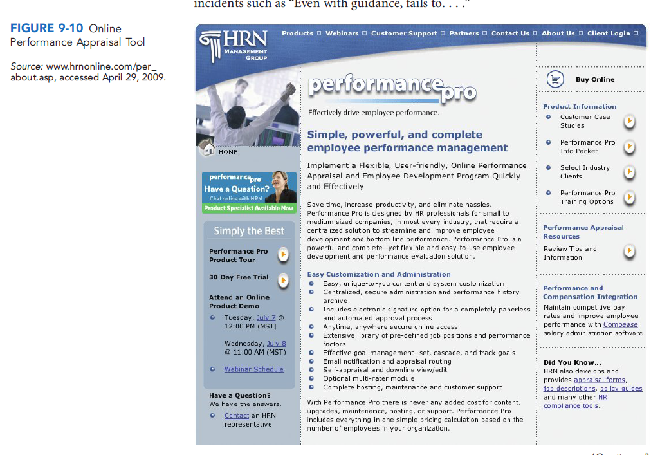

Slide 44
DEALING WITH APPRAISAL PROBLEMS
AND INTERVIEWS
As we said, few things managers do are fraught with more peril than appraising
subordinates performance.50 We now turn to appraisal problems and how to solve
them, and to several other appraisal issues. Potential Appraisal Problems
Graphic-type rating scales in particular are susceptible to several problems: unclear
standards, halo effect, central tendency, leniency or strictness, and bias.
UNCLEAR STANDARDS
Table 9-2 illustrates the unclear standards problem. This graphic rating scale seems objective. However, it would probably result in unfair appraisals, because the traits and degrees of merit are ambiguous. For example, different supervisors might define good performance, fair performance, and so on differently. The same is true of traits such as quality of work or creativity.
The best way to fix this problem is to include descriptive phrases that define or
illustrate each trait, as in Figure 9-3. That form spells out what measures like Role
Model or Below Expectations mean. This specificity results in more consistent and
more easily explained appraisals.

Slide 45
CONTD:-
HALO EFFECT
Experts define halo effect as the influence of a rater s general
impression on ratings of specific ratee qualities. For example, supervisors often
rate unfriendly employees lower on all traits, rather than just on gets along well with others. Being aware of this problem is a step toward avoiding it. Supervisory training can also alleviate the problem, as can using a BARS (on which, recall, the performance dimensions are usually independent of each other).
CENTRAL TENDENCY
Some supervisors stick to the middle when filling in rating scales. For example, if the rating scale ranges from 1 to 7, they tend to avoid the highs (6 and 7) and lows (1 and 2) and rate most of their people between 3 and 5. Central tendency means rating all employees average. Doing so distorts the evaluations, making them less useful for promotion, salary, or counseling purposes. Ranking employees instead of using graphic rating scales can reduce this problem, since ranking means you can t rate them all average.

Slide 46
CONTD:-
LENIENCY OR STRICTNESS
Other supervisors tend to rate all their subordinates consistently high or low, just as some instructors are notoriously high or low graders. This strictness/leniency problem is especially severe with graphic rating scales. On the other hand, ranking forces supervisors to distinguish between high and low performers. There are other solutions. One is for the employer to recommend that supervisors avoid giving all their employees high (or low) ratings. A second is to basically enforce a distribution that, say, about 10% of the people should be rated excellent, 20% good, and so forth. (But beware: Sometimes what appears to be an error such as leniency isn t an error at all, as when all subordinates really are superior performers.)
RECENCY EFFECTS The recency effect means letting what the employee has done recently blind you to what his or her performance has been over the year. The main solution is to accumulate critical incidents all year long.
BIAS The number of things that can lead to bias during appraisals is limitless. One study focused on the rater s personality.Raters who scored higher on conscientiousness tended to give their peers lower ratings they were stricter, in other words; those scoring higher on agreeableness gave higher ratings they were more lenient.
In another study, performance appraisal ratings obtained for administrative purposes [such as pay
raises or promotions] were nearly one-third [higher] than those obtained for research or
employee development purposes. 55 Another writer says, performance ratings amplify
the quality of the personal relationship between boss and employee. Good relationships
tend to create good [appraisal] experiences, bad relationships bad ones. 5

Slide 47
CONTD:-
Unfortunately, personal characteristics (such as age, race, and sex) also affect ratings.A 36-year-old supervisor ranked a 62-year-old subordinate at the bottom of the department s rankings, and then fired him. The court held that the younger boss s discriminatory motives might have prejudiced the dismissal decision.
In one study, promoted women had to receive higher performance ratings than promoted men to be promoted, suggesting that women were held to stricter standards for promotion. Another study found that raters might actually penalize successful women for their success.
Other studies suggest that, rater idiosyncratic biases account for the largest percentage of the observed variances in performance ratings. The bottom line is that the appraisal often says more about the appraiser than about the appraisee.61 This is a powerful reason for using multiple raters, for having the supervisor s boss review the rating, and/or for having what some employers call calibration meetings; here supervisors discuss among themselves their reasons for the appraisals they gave each of their subordinates.

Slide 48
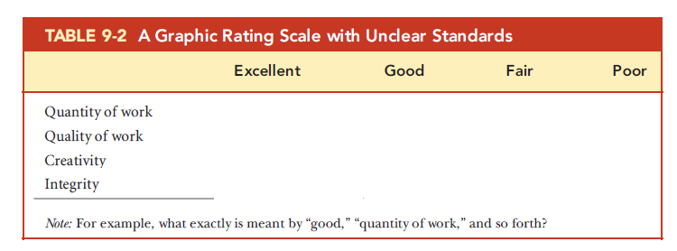
CONTD:-

Slide 49
PERFORMANCE MANAGEMENT
Earlier in this chapter,we said that performance management is the continuous process of identifying, measuring, and developing the performance of individuals and teams and aligning their performance with the organizations goals.We look at performance management more closely in this section.
Performance Management vs. Performance Appraisal
In comparing performance management and performance appraisal, the distinction is
the contrast between a year-end event the completion of the appraisal form and a
process that starts the year with performance planning and is integral to the way people
are managed throughout the year.
Three main things distinguish performance management from performance appraisal.
1. First, performance management never means just meeting with a subordinate
once or twice a year to review your performance. It means continuous, daily, or
weekly interactions and feedback to ensure continuous improvement.72
2. Second, performance management is always goal-directed. The continuing
performance reviews always involve comparing the employee s or teams
performance against goals that specifically stem from and link to the company s
strategic goals. Strategic congruence is central to performance management: each
employee s goals must be aligned with departmental and company goals.
3. Third, performance management means continuously reevaluating and (if need be)
modifying how the employee and team get their work done. Depending on the issue,
this may mean additional training, changing work procedures, or instituting new
incentive plans, for instance.
Furthermore, performance management systems increasingly use information
technology to help managers automatically track employee performance and take

Slide 50
CONTD:-
immediate corrective action as required. By comparison, performance appraisal
systems usually rely on paper forms, or perhaps online or computerized appraisal
forms. We can summarize performance management s six basic elements as follows:
* Direction sharing means communicating the company s goals throughout the
company and then translating these into doable departmental, team, and individual
goals.
* Goal alignment means having a method that enables managers and employees
to see the link between the employees goals and those of their department and
company.
* Ongoing performance monitoring usually includes using computerized systems that measure and then e-mail progress and exception reports based on the person s progress toward meeting his or her performance goals.
* Ongoing feedback includes both face-to-face and computerized feedback regarding
progress toward goals.
* Coaching and developmental support should be an integral part of the feedback
process.
* Recognition and rewards provide the consequences needed to keep the employee s
goal-directed performance on track.

Slide 51
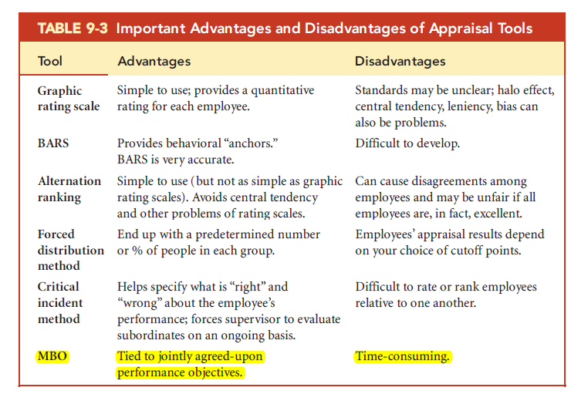

Slide 52
Managing the Appraisal Interview
The appraisal typically culminates in an appraisal interview. Here you and the subordinate review the appraisal and make plans to remedy deficiencies and reinforce strengths. Interviews like these are often uncomfortable. Few people like to receive or give negative feedback. Adequate preparation and effective implementation are therefore essential.
TYPES OF APPRAISAL INTERVIEWS
Supervisors face four types of appraisal interviews, each with its unique objectives:
Satisfactory Promotable is the easiest interview: The person s performance is satisfactory and there is a promotion ahead. Your objective is to discuss the person s career plans and to develop a specific professional development plan.
Satisfactory Not promotable is for employees whose performance is satisfactory but for whom promotion is not possible. The objective here is to maintain satisfactory performance. The best option is usually to find incentives that are important to the person and sufficient to maintain performance. These might include extra time off, a small bonus, and reinforcement, perhaps in the form of an occasional well done! When the person s performance is unsatisfactory but correctable, the interview objective is to lay out an action plan (see Figure 9-13) for correcting the unsatisfactory performance.
Finally, if the employee is unsatisfactory and the situation is uncorrectable
you can usually skip the interview. You either tolerate the person s poor performance for now, or (more likely) dismiss the person.

Slide 53
CONTD:-
HOW TO CONDUCT THE APPRAISAL INTERVIEW
Beforehand, review the person s job description, compare performance to the standards, and review the previous appraisals.Give the employee at least a week s notice to review his or her work.
Set a time for the interview and allow enough time. Interviews with lower-level personnel like clerical workers should take no more than an hour. Interviews with management employees often take 2 or 3 hours. Conduct the interview in a private place with no interruptions.
There are four things to keep in mind when conducting the interview:
1. Talk in terms of objective work data. Use examples such as absences, tardiness, quality records, orders processed, productivity records, and so on.
2. Don t get personal. Don t say, You re too slow in producing those reports. Instead, try to compare the person s performance to a standard. ( These reports should normally be done within 10 days. ) Similarly, don t compare the person s performance to that of other people. ( He s quicker than you are. )
3. Encourage the person to talk. Stop and listen to what the person is saying; ask open-ended questions such as, What do you think we can do to improve the situation? Use a command such as Go on. Restate the person s last point as a question, such as, You don t think you can get the job done?
4. Get agreement.Make sure the person leaves knowing specifically what he or she is doing right and doing wrong and with agreement on how things will be improved, and by when.Write an action plan (Figure 9-13) with targets and dates. Whether subordinates express satisfaction with their appraisal interview depends on several things. Subordinates will prefer:
1. not feeling threatened during the interview;
2. having an opportunity to present their ideas and feelings and to influence the
course of the interview; and
3. having a helpful and constructive supervisor conduct the interview.

Slide 54
CONTD:-
HOW TO HANDLE A DEFENSIVE SUBORDINATE
Defenses are a familiar aspect of our lives.When a supervisor tells someone his or her performance is poor, the first reaction is often denial. Denial is a defense mechanism. By denying the fault, the person avoids having to question his or her own competence. Others react with anger and aggression. This helps them let off steam and postpones confronting the immediate problem.
In any event, understanding and dealing with defensiveness is an important
appraisal skill. In his book Effective Psychology for Managers, psychologist Mortimer
Feinberg suggests the following:
1. Recognize that defensive behavior is normal.
2. Never attack a person s defenses. Don t try to explain someone to themselves
by saying things like, You know the real reason you re using that excuse is that
you can t bear to be blamed. Instead, concentrate on the fact ( sales are down ).
3. Postpone action. Sometimes it is best to do nothing. Employees may react to
sudden threats by instinctively hiding behind their defenses. But given sufficient
time, a more rational reaction takes over.
4. Recognize your own limitations.The supervisor should not try to be a psychologist.
Offering understanding is one thing; trying to deal with psychological problems
is another.

Slide 55
CONTD:-
HOW TO CRITICIZE A SUBORDINATE When you must criticize, do so in a manner that lets the person maintain his or her dignity in private, and constructively.Provide examples of critical incidents and specific suggestions of what to do and why. Avoid once-a-year critical broadsides by giving feedback periodically, so that the formal review contains no surprises. Never say the person is always wrong (since no one is ever always wrong or right). Criticism should be objective and free of personal bias.
HOW TO HANDLE A FORMAL WRITTEN WARNING An employee s performance may be so weak that it requires a formal written warning. Such warnings serve two purposes: (1) They may serve to shake your employee out of his or her bad habits, and (2) they can help you defend your rating, both to your own boss and (if needed) to the courts. Written warnings should identify the employee s standards,make it clear that the employee was aware of the standard, specify any deficiencies relative to the standard, and show the employee had an opportunity to correct his or her performance.
REALISTIC APPRAISALS When the employee is not doing well, the manager will have to decide how candid to be. Not all managers are devotees of candor, but some firms, like GE, are famous for hard-hearted appraisals. GE s former CEO Jack Welch once said, for instance, that it is cruel to tell someone who s doing a mediocre job that their work is satisfactory. Someone who might have had the chance to correct bad behavior or find a more appropriate vocation may instead spend years in a dead-end job, only to have to leave when a more demanding boss arrives.
There are many practical motivations for giving soft appraisals: the fear of having to hire and train someone new; the appraisee s unpleasant reactions; or a company appraisal process that s not conducive to candor, for instance. Ultimately, the person doing the appraising must decide if the drawbacks of less-than-candid appraisals outweigh the assumed benefits. They rarely do.

Slide 56
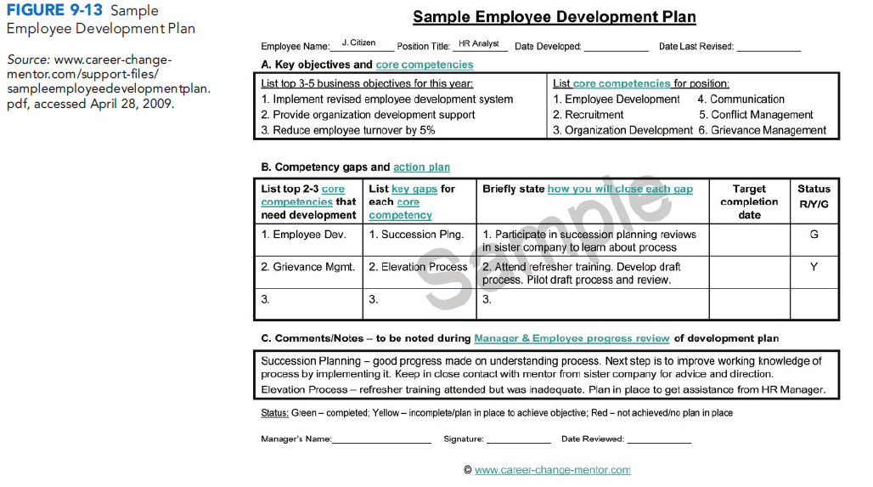
CONTD:-

Slide 57
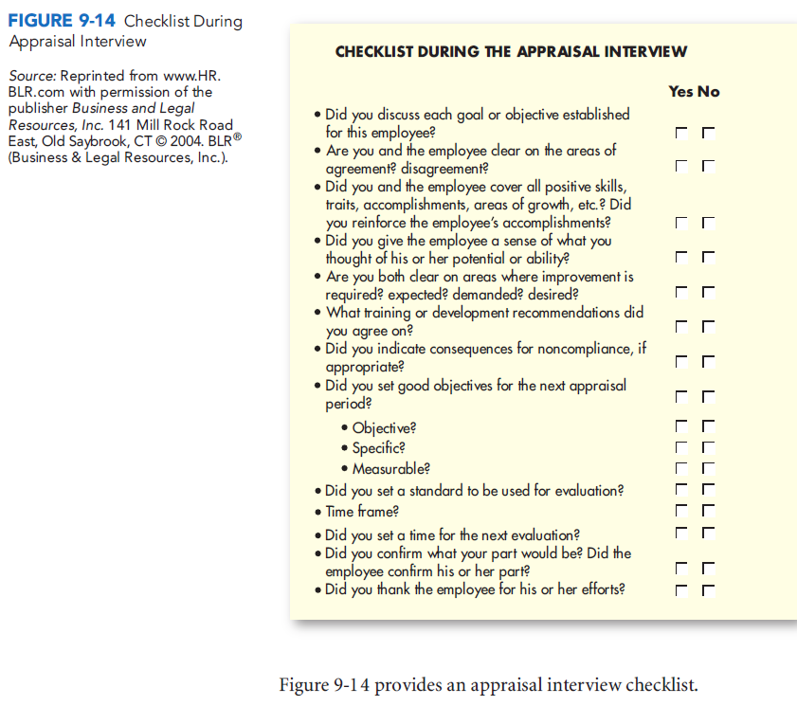
CONTD:-

Slide 58
Thank you for reading.
This is the end of Chapter Performance Management.

